Slide 1
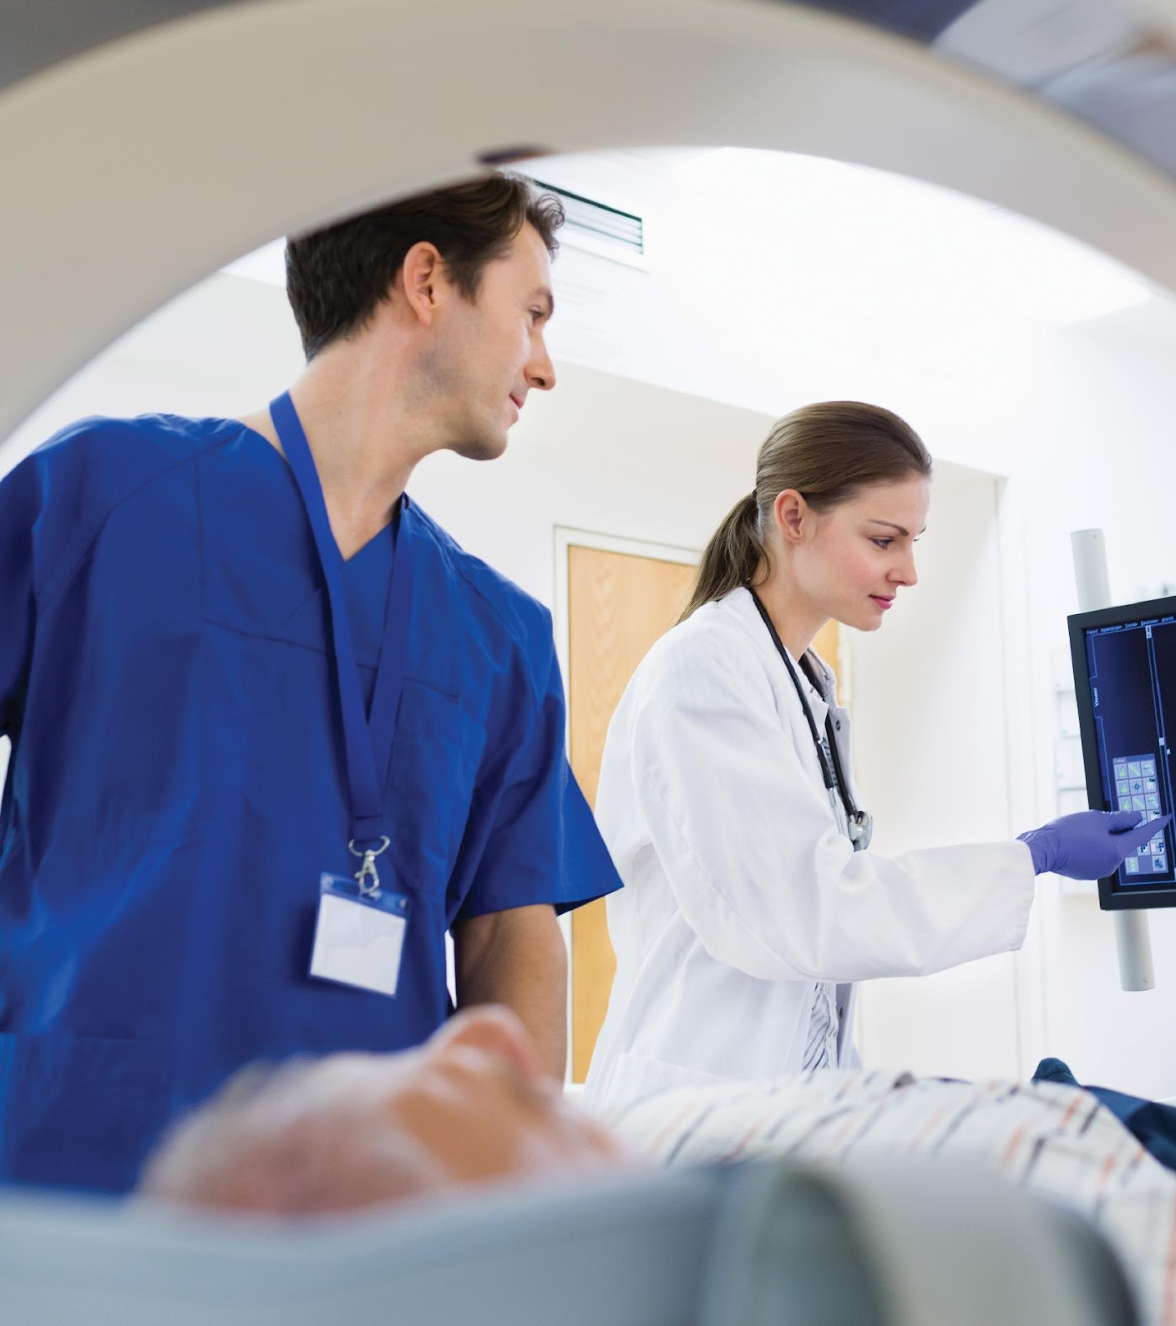
AGM Investor Presentation
Changing the way we look at cancer
31 May 2024
Level 25, 525 Collins Street, Melbourne and virtually via the Lumi platform
Imagion Biosystems Limited
ImagionBiosystems.com
ASX:IBX

Slide 2
Welcome to the Annual General Meeting of Imagion Biosystems Limited
We advise that we have complied with the relevant requirements for convening this meeting, and that a quorum is present.
I therefore declare the meeting open.

Slide 3
FORMAT OF THE MEETING
Welcome
Introductions and Format of Meeting
Q&A, Voting and Poll Procedure
Chair Address
Formal Business
Receipt and Consideration of Accounts & Reports
Resolution 1: Adoption of Remuneration Report
Resolution 2: Re-Election of Director – Mr Michael Harsh
Resolution 3: Re-Election of Director – Mr Mark Van Asten
Resolution 4: Spill Resolution – Conditional Resolution
Close of Meeting

Slide 4
Q&A / VOTING PROCEDURE

Slide 5
IN PERSON VOTING INSTRUCTIONS

Slide 6
ONLINE VOTING INSTRUCTIONS
Select the voting tab
Select your voting preference for each resolution
Your selected option will change colour
You can change your vote until the poll is closed

Slide 7
Online Text Questions
Select the messaging tab
Type your question in the ‘Ask a question’ box
Press the arrow symbol to submit your message
Select ‘My Messages’ to view your submitted messages along with any written responses

Slide 8
Online Text Questions
Select the messaging tab
Select the category of your question
Type your question in the ‘Ask a question’ box
Press the arrow symbol to submit your message
Select ‘My Messages’ to view your submitted messages along with any written responses

Slide 9
Online Audio Questions
Click ‘Request to Speak’
Enter the topic of your question
Click ‘Submit Request’
Click ‘Join Queue’ and follow the audio prompts

Slide 10
CHAIRMAN'S ADDRESS

Slide 11
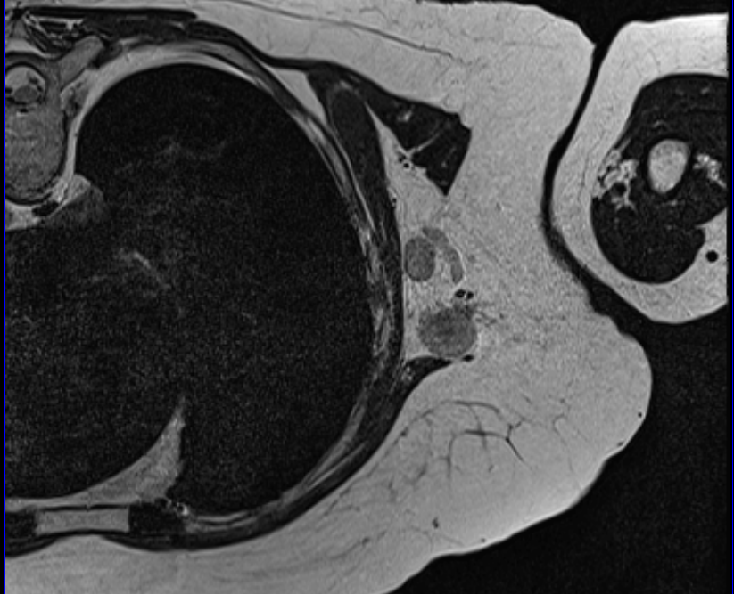
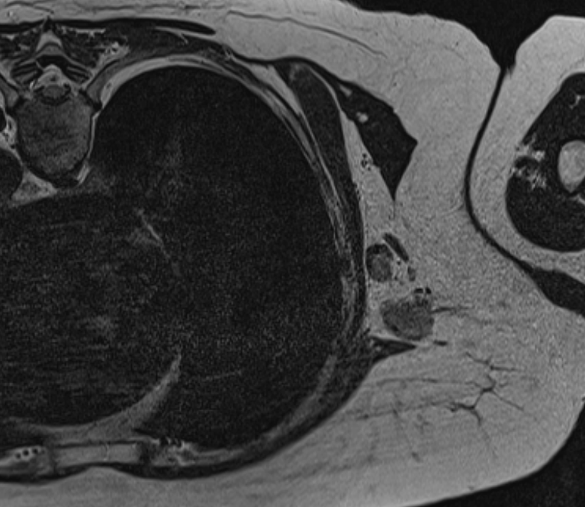
MagSense® Imaging with MRI
Changing the way we look at cancer
Pre-Dose T2
A Phase I study has been completed and the data indicate our molecularly targeted nanoparticles could be effective in detecting nodal disease in HER2 breast cancer patients when used in conjunction with conventional MRI scanners
MagSense® imaging agents work within current standard of care diagnosis and staging protocols with MRI systems widely available in hospitals around the globe
The MagSense® HER2 imaging agent is ready to advance to Phase 2 of clinical investigation pending Investigational New Drug (IND) approval from the FDA.
Two additional MagSense® targeted imaging agents, one for prostate cancer and one for ovarian cancer, are ready for IND enabling studies.
MagSense® nanoparticles enable molecular imaging by producing an identifiable change in image contrast when cancer cells are present
Post-Dose T2

Slide 12
IMAGION 2.0
Leaner and Restructured
Outsource rather than build infrastructure; use consultants and contractors.
Pay-as-you-go matching spending to funding.
Emphasis on performance-based compensation.
Value in our IP
MagSense® is a first-of-its-kind technology to enable molecular MRI.
The “platform” has been demonstrated with imaging agents for three different types of cancer.
Our Phase 1 data combined with an IND approval by the FDA will be seen as a significantly de-risking and attractive to partners.

Slide 13
The value in molecular MRI
MagSense® Technology Platform
HER2 breast cancer nodal detection is a US$200M market with standard of care limited to detecting “suspicious nodes”.
Prostate cancer detection is a US$2B market with millions of biopsies performed because imaging is not the standard for diagnosis.
Ovarian cancer remains the “silent killer” because TVUS is not sensitive enough for early detection.
Strategic Partnerships
Big pharma and medical device companies routinely use M&A to build their portfolio.
Hologic bought Endomagnetics iron oxide tracer agent for $300M
Advancing through clinical investigations de-risks the technology and increases the transactional value of the technology.

Slide 14
FORMAL BUSINESS

Slide 15
Receipt and Consideration of Accounts & Reports
To receive and consider the Financial Report of the Company and its controlled entities and the related Directors’ and Auditor’s Reports in respect of the financial year ended 31 December 2023.
Further Information
There is no requirement in relation to the receipt and consideration of Accounts and Reports.
As this matter does not require a vote, we will now open the poll and Shareholders and their representatives may cast their votes as and when the Resolutions are being addressed. You will also have some time after all the Resolutions have been addressed to cast your votes.

Slide 16
Resolution 1: Adoption of Remuneration Report
To consider and, if thought fit, to pass the following resolution as an ordinary resolution:
“That the Remuneration Report of the Company and its controlled entities for the year ended 31
December 2023 be adopted in accordance with section 250R of the Corporations Act.”
Proxy Results:
Further Information
The Remuneration Report is set out in the Company’s Annual Report.
Undirected proxies include express authorisation for the Chairman to vote as they see fit and will be voted in favour of Resolution 1
Voting Exclusions apply as set out in the Notice of Meeting
FOR | AGAINST | DISCRETIONARY | ABSTAIN/ EXCLUDE
148,905 43.03% | 161,034 46.53% | 36,129 10.44% | 43,370 -

Slide 17
Resolution 2: Re-Election of Director – Mr Michael Harsh
To consider and, if thought fit, to pass the following resolution as an ordinary resolution:
“That Mr Michael Harsh, being a Director, who retires in accordance with clause 20.3 of the
Company’s Constitution and ASX Listing Rule 14.5 and being eligible, be re-elected as a Director
of the Company.”
Proxy Results:
Further Information
The Board (Mr. Harsh recommends that Shareholders vote in favour of Resolution 2
Mr. Harsh’s experience is set out in the Explanatory Statement of the Notice of Meeting
FOR | AGAINST | DISCRETIONARY | ABSTAIN/ EXCLUDE
199,029 51.73% | 146,267 38.02% | 39,440 10.25% | 4,702 -

Slide 18
Resolution 3: Re-Election of Director – Mr Mark Van Asten
To consider and, if thought fit, to pass the following resolution as an ordinary resolution:
“That Mr Mark Van Asten, being a Director, who retires in accordance with clause 20.3 of the
Company’s Constitution and ASX Listing Rule 14.5 and being eligible, be re-elected as a Director
of the Company.”
Proxy Results:
Further Information
The Board (Mr. Mark Van Asten recommends that Shareholders vote in favour of Resolution 3
Mr. Mark Van Asten’s experience is set out in the Explanatory Statement of the Notice of Meeting
FOR | AGAINST | DISCRETIONARY | ABSTAIN/ EXCLUDE
187,750 50.82% | 146,267 39.60% | 35,390 9.58% | 20,031 -

Slide 19
Resolution 4: Spill Resolution – Conditional Resolution
To consider and, if thought fit, to pass the following resolution as an ordinary resolution:
“That subject to and conditional on at least 25% of the votes validly cast on Item 2 (Resolution 1, Adoption of the Remuneration Report) being cast against the adoption of the Remuneration Report for the year ended 31 December 2023:
a. a general meeting of the Company (Spill Meeting) be held within 90 days after passing of this resolution;
b. all the directors of the Company in office at the time when the resolution to make the Director’s Report for the financial year ended 31 December 2023 was passed, other than the Managing Director, cease to hold office immediately before the end of the Spill Meeting; and
c. resolutions to appoint persons to offices that will be vacated immediately before the end of the Spill Meeting be put to the vote at the Spill Meeting.”
Proxy Results:
Further Information
Any member of the Company’s Key Management Personnel and their Closely Related Parties are not entitled to vote on this Resolution in any capacity.
The Board does not consider the proposed resolution to be in the best interests of the Company or its Shareholders. The Board recommends that Shareholders vote AGAINST any spill resolution put to the vote at the AGM.
The Chair of the Annual General Meeting intends to vote undirected proxies AGAINST this Resolution.
FOR | AGAINST | DISCRETIONARY | ABSTAIN/ EXCLUDE
157,318 50.34% | 115,545 36.97% | 39,674 12.69% | 76,901 -

Slide 20
Q&A SESSION

Slide 21
VOTING CLOSED /
END OF FORMAL BUSINESS
That concludes the presentations to be given today, I thank you for attending and I declare the meeting closed.
Thank you for your attendance and we look forward to your continued support.

Slide 22
Disclaimers
This investor presentation (Presentation) has been prepared by Imagion Biosystems Limited (Imagion or the Company). This presentation does not constitute or form part of, and should not be construed as, an offer, solicitation or invitation to subscribe for, underwrite or otherwise acquire, any securities of Imagion or any member of its group nor should it or any part of it form the basis of, or be relied on in connection with, any contract to purchase or subscribe for any securities of Imagion or any member of its group, nor shall it or any part of it form the basis of or be relied on in connection with any contract or commitment whatsoever.
This presentation is not a Prospectus and contains summary information about Imagion and its activities, which is current as at the date of this presentation. The information included in this presentation is of a general nature and does not purport to be complete nor does it contain all the information which a prospective investor should consider when making an investment decision. Each recipient of this presentation should make its own enquiries and investigations regarding all information in this presentation including but not limited to the assumptions, uncertainties and contingencies which may affect future operations of Imagion and the impact that different future outcomes may have on Imagion. This presentation has been prepared without taking account of any person’s investment objectives, financial situation or particular needs. Before making an investment decision, prospective investors should consider the appropriateness of the information having regard to their own objectives, financial situation and needs, make their own assessment of the information and seek legal, financial, accounting and taxation advice appropriate to their jurisdiction in relation to the information and any action taken on the basis of the information.
The information included in this presentation has been provided to you solely for your information and background and is subject to updating, completion, revision and amendment and such information may change materially. Unless required by applicable law or regulation, no person (including Imagion) is under any obligation to update or keep current the information contained in this presentation and any opinions expressed in relation thereto are subject to change without notice. No representation or warranty, express or implied, is made as to the fairness, currency, accuracy, reasonableness or completeness of the information contained herein. Neither Imagion nor any other person (including its shareholders, directors, officers and employees) accepts any liability and Imagion, its shareholders, its related bodies corporate and their respective directors, officers and employees, to the maximum extent permitted by law, expressly disclaim all liabilities for any loss howsoever arising, directly or indirectly, from this presentation or its contents.
This presentation includes forward-looking statements that reflect Imagion's intentions, beliefs or current expectations concerning, among other things, Imagion's results of operations, financial condition, performance, prospects, growth, strategies and the industry in which Imagion operates. These forward-looking statements are subject to risks, uncertainties and assumptions and other factors, many of which are beyond the control of Imagion. Imagion cautions you that forward-looking statements are not guarantees of future performance and that its actual results of operations, financial condition, performance, prospects, growth or opportunities and the development of the industry in which Imagion operates may differ materially from those made in or suggested by the forward-looking statements contained in this presentation. In addition, Imagion does not guarantee any particular rate of return or the performance of Imagion nor does it guarantee the repayment or maintenance of capital or any particular tax treatment. Investors should note that past performance may not be indicative of results or developments in future periods and cannot be relied upon as an indicator of (and provides no guidance as to) Imagion's future performance. Imagion, its related bodies corporate and each of their respective directors, officers and employees and advisers expressly disclaim any obligation or undertaking to review, update or release any update of or revisions to any forward-looking statements in this presentation or any change in Imagion's expectations or any change in events, conditions or circumstances on which these forward-looking statements are based, except as required by applicable law or regulation.
This presentation and any materials distributed in connection with this presentation are not directed to, or intended for distribution to or use by, any person or entity that is a citizen or resident or located in any locality, state, country or other jurisdiction where such distribution, publication, availability or use would be contrary to law or regulation or which would require any registration or licensing within such jurisdiction.
The distribution of this presentation in certain jurisdictions may be restricted by law and persons into whose possession this presentation comes should inform themselves about and observe any such restrictions.
Notes:
DONE

Slide 23
www.imagionbiosystems.com
info@imagionbio.com
ASX:IBX

